Slide 1
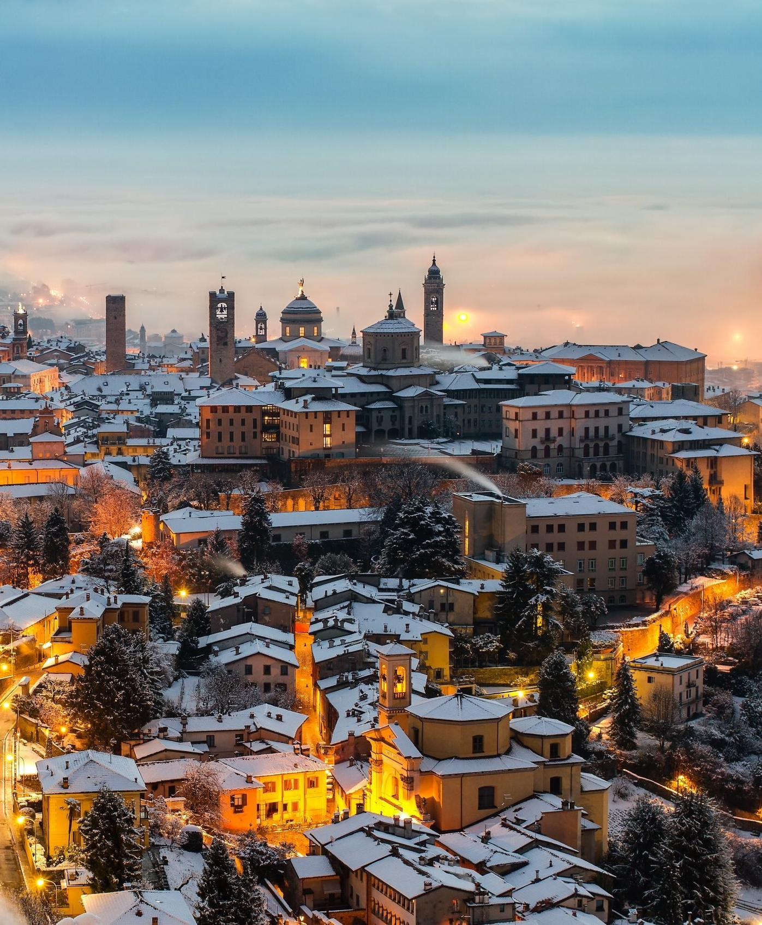
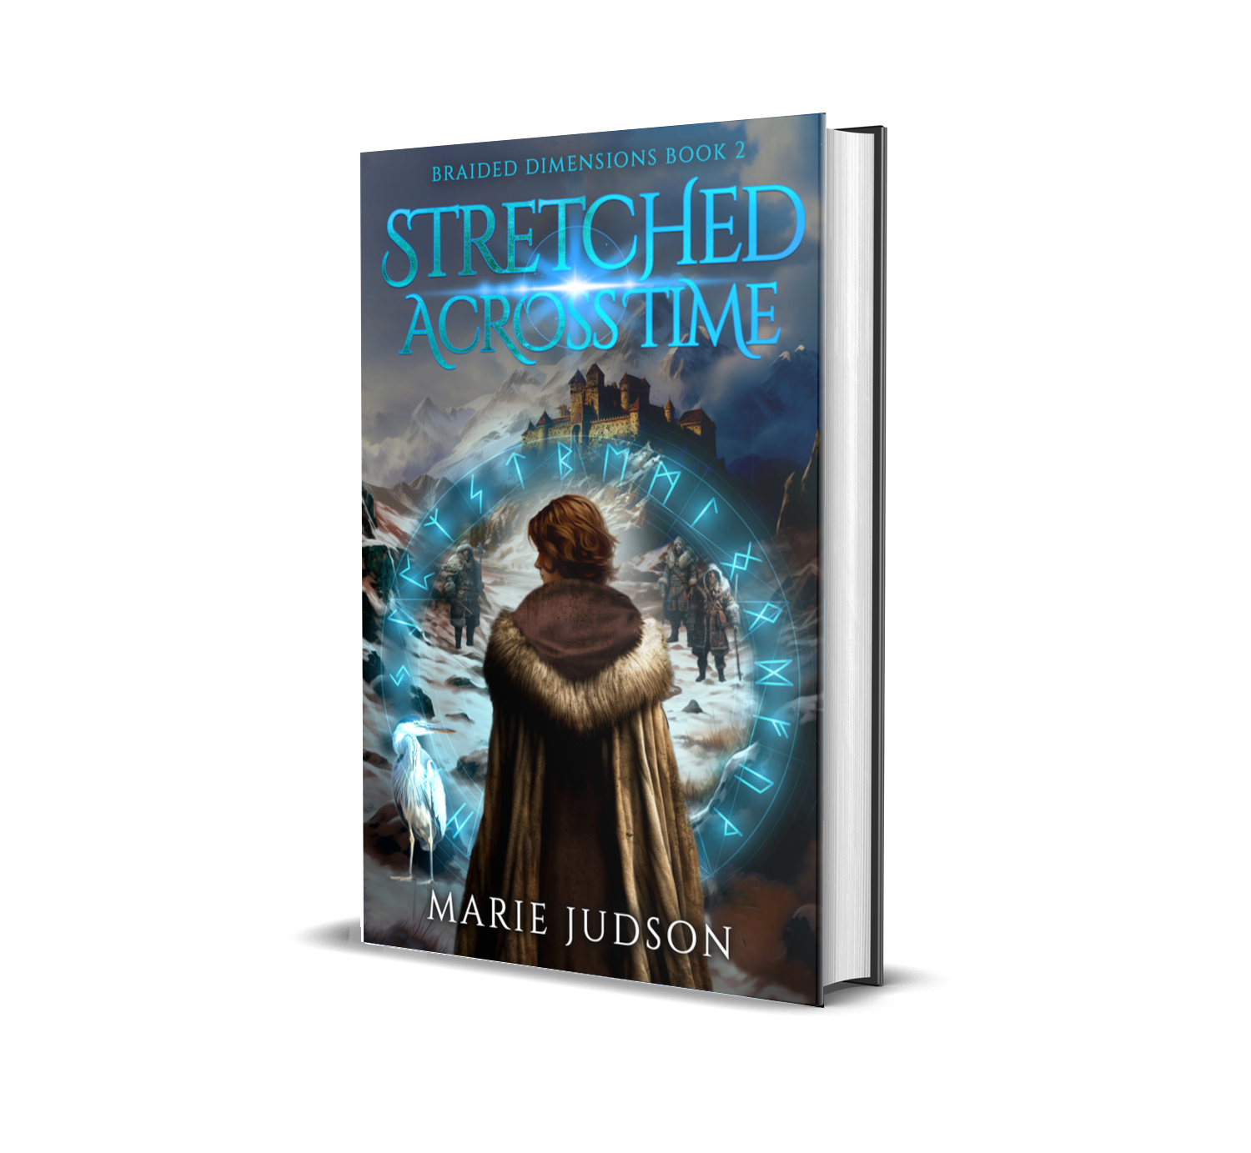
Stretched Across Time
Book Club Resource Guide
“A well-written story of fantasy in medieval times”
Amazon Reviewer
“A fantastic follow up in this uniquely compelling time-travel adventure”
Goodreads Reviewer
Click to watch the trailer

Slide 2
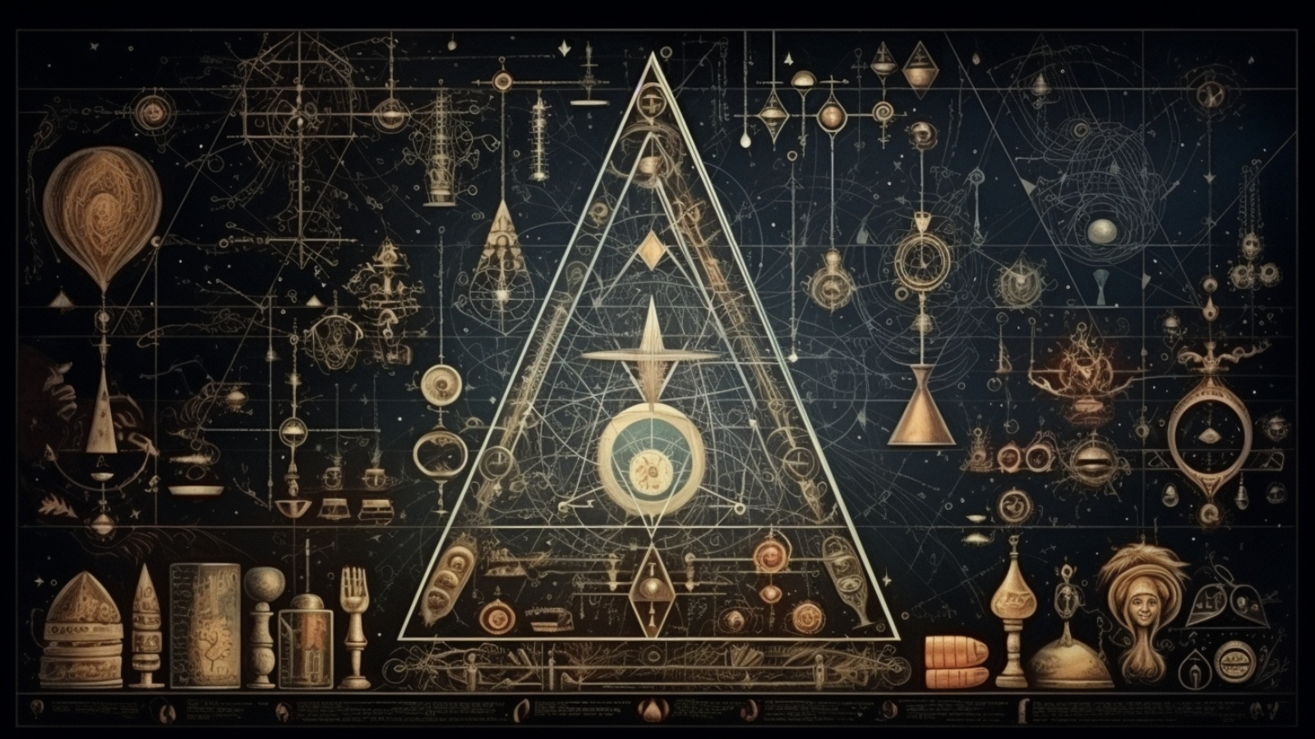
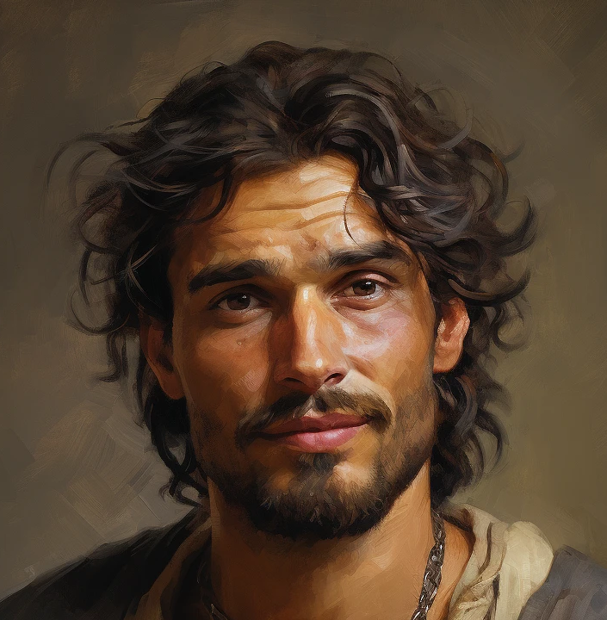
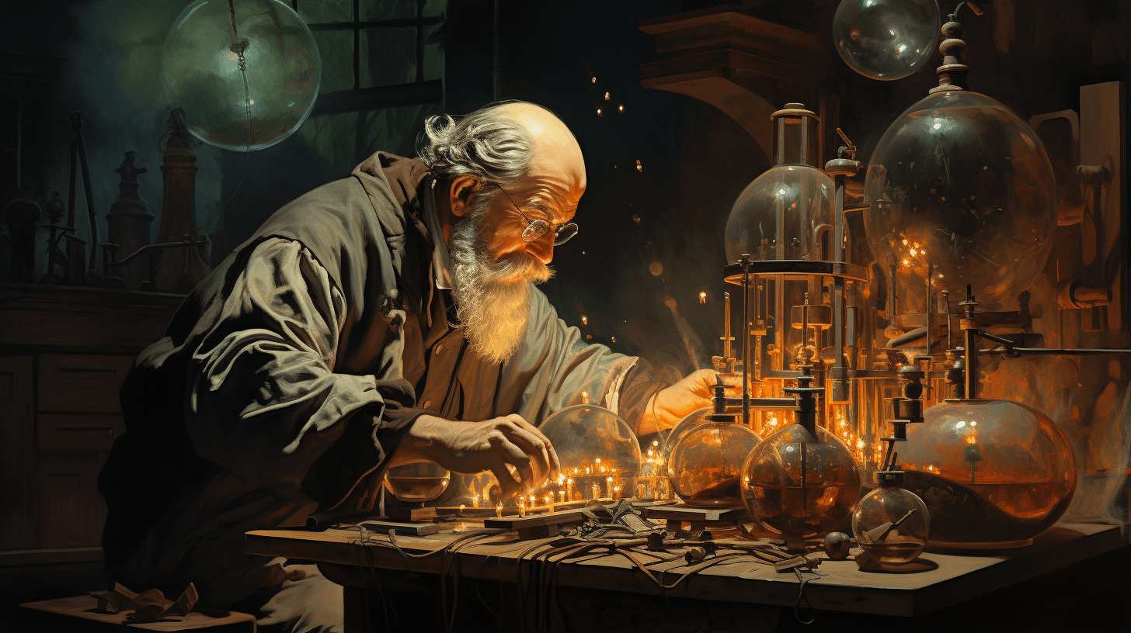
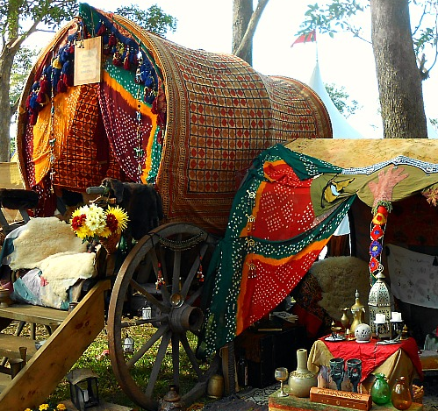
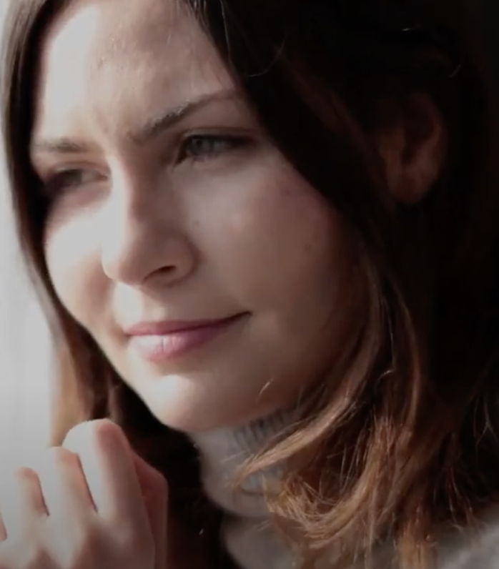
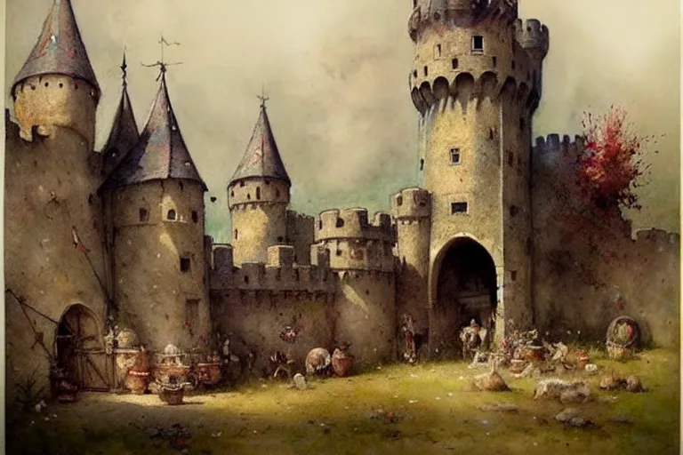
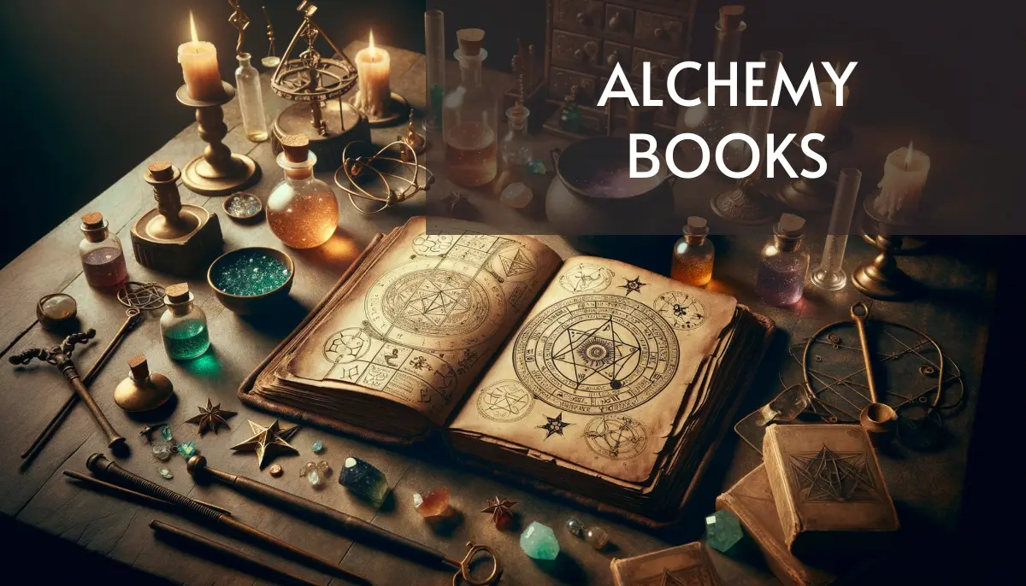
Thank you for considering Stretched Across Time for your next book club read!

Slide 3

Celtic mythology, medieval history, and modern-day mystery blend in this story where past and present collide.
Synopsis
Kay has been drawn into a vortex of intrigue in the ancient world, of magic-wielding Wanderers, mesmerizing sylphs, powerful Nordic shamans, crafty mages. And now she cannot deny that her children are involved. Her son is channeling stories of abductions by threatening pirates. Her daughter’s mysterious lover sounds uncannily like a tenth-century Welsh musician. She tries to pull away from the medieval world but finds herself increasingly enamored with her spirit-travel. Is she the only one who can rescue her friends, who can tread in ancient caverns undetected to mind-meld with marauding ancient Jutlanders? If she takes the next journey to the past, will she ever see her children again?

Slide 4
Discussion Questions
How do the settings of the book contribute to the feeling?
Describe a part of the settings that elicited a particular response in you.
Which character(s) do you identify with?
If you could be one of the characters or experience one of the settings which would it be?
What powers in this book would you want to have?
At any point, did you think the plot would evolve differently?
Are you eager to go on with the series and read Strange Alliances?
How would you describe the author's writing style?
What words or ideas created atmosphere?
Which character or characters are most memorable and why?

Slide 5
Book Trivia Questions
What is Kay’s work?
What part of California does Kay live in?
Where does she work at the start of the story?
Who is it that she looks like?
What is Duff’s relationship to her doppelganger?
Who is the bad guy?
Where does Kay time-travel to?
What is Kyna’s profession?
Who is Baird and how does he know Kyna?

Slide 6
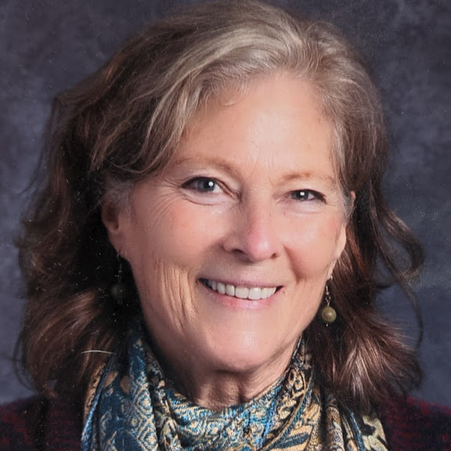
About the author
Marie Judson has been a professor, journal editor, and coffee roaster. Now a teacher on the northern coast of California, she has written five fantasy and science fiction novels. Some of her passions are studying dreams and dream symbols, singing harmony, and working toward a sustainable earth.
Marie is happy to participate in blog tours and other engagements with book groups. Reach out to her at her website, sign up to receive her newsletter, and follow her on Instagram: marie.judson.writer

Slide 7

Story Themes
Search for Meaning: Kay tastes the reality of what she’s only studied.
Family: Kay fears that her travel to the past could affect her grown children.
Connection to roots: Kay encounters a time when life touched spirit, soul and magic

Slide 8
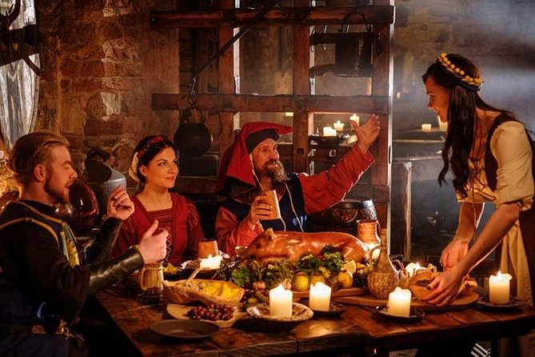
Come join the magic!
  Bonus for groups: contact me about your book club’s participation and I will provide an exclusive culminating party plan!

